Slide 1
NYC Property Sales Price Prediction
Team 9: Niranjana Balakrishnan, Dier Gao,
Prateek Choukse, Yi Xiong, Badar Almarri

Slide 2
Outline
Problem statement
Motivation
Literature
Data Description
Data exploration
Data preprocessing
Modeling
Model comparison
Business insights

Slide 3
Introduction
Background
The dataset is from the New York Department of Finance which contains all property sales among all tax classes over the period of 12 months.
Problem Statement
Around 84K New York property sales records in NYC real estate market with 18 predictor variables has been provided for the months between September 2016- August 2017. Our aim is to predict the sale price of future property sales.

Slide 4
Motivation
To identify potential property sale prices in a certain region
To design targeted market campaigns so that real estate agencies could save cost and increase profits
To recognize potential growth/new markets for companies to explore
To help real estate agencies to target suitable locations for the desired property

Slide 5
Literature
Data Normalization
Encoding Building Class to Numerical Rankings
New Models
Neural Networks
Gradient Boosting
Support Vector Regression(SVR)

Slide 6
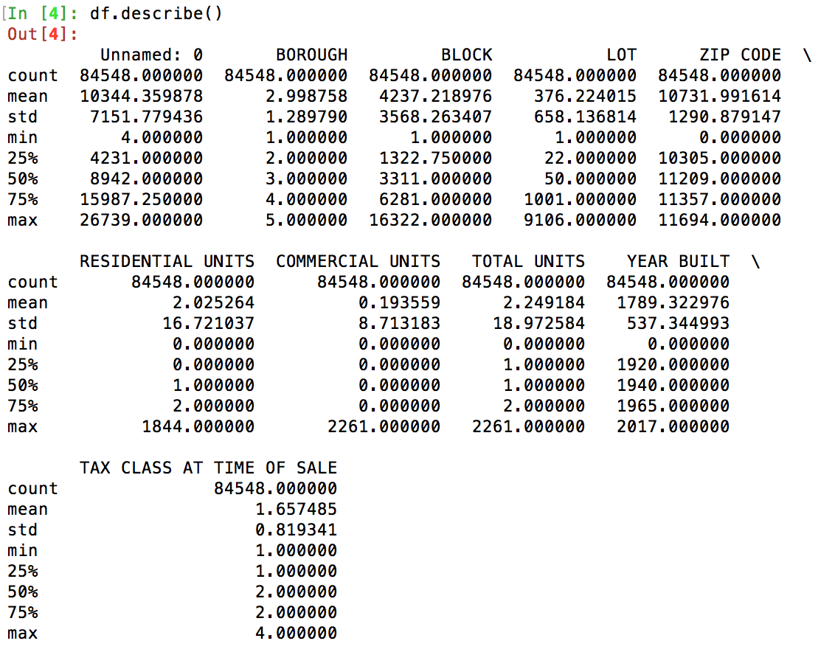
Data Description
Number of Records : 84548
Number of Predictors : 18
Target variable: SALE PRICE

Slide 7
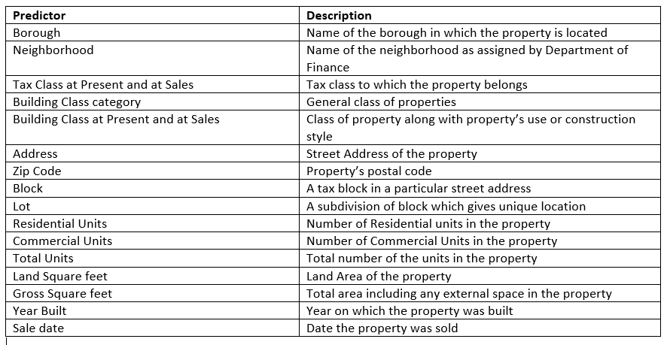
Data Description

Slide 8
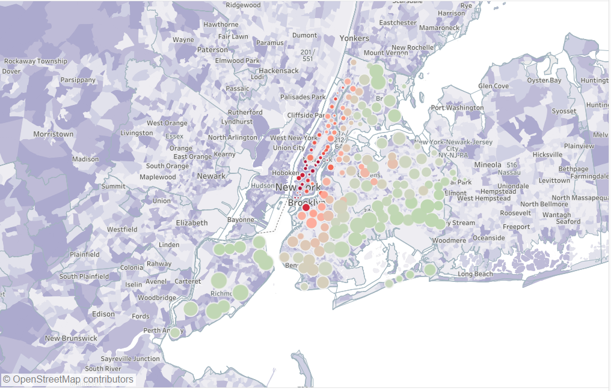
Data exploration
Let’s start with the first set of slides

Slide 9
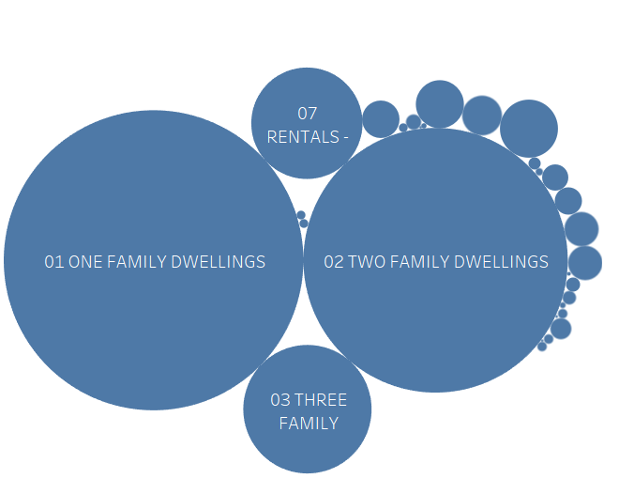
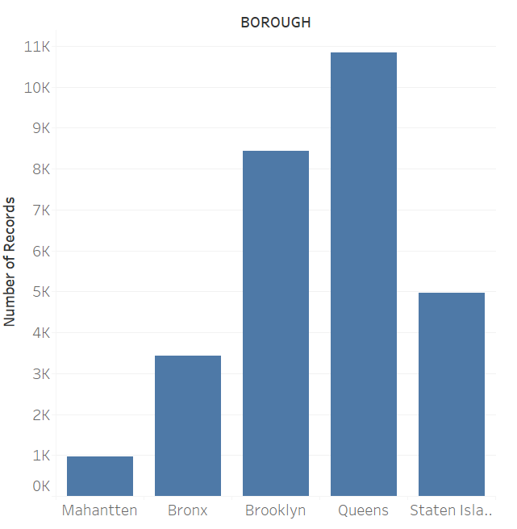
Data exploration Cont.

Slide 10
Data Preprocessing
Data reduction
Data cleaning
Data transformation

Slide 11
Data Preprocessing Cont.
Data reduction
Delete variables with too many categories.
'NEIGHBORHOOD': 254 categories.
‘ADDRESS': 67563 categories.
Delete variables with redundant information
‘TOTAL UNITS’: ‘TOTAL UNITS’ = 'RESIDENTIAL UNITS' + 'COMMERCIAL UNITS'.
Delete variables with higher than 70% missing values
'EASE-MENT'
'APARTMENT NUMBER'

Slide 12
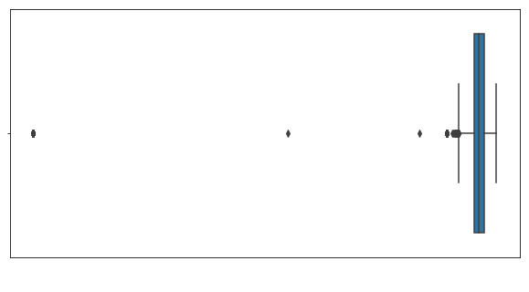
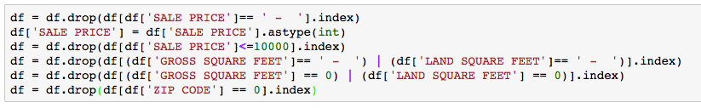
Data Preprocessing Cont.
Data cleaning
Deal with outliers
Delete values where 'YEAR BUILT’ < 1,750
Deal with missing values
Delete NA’s in 'BUILDING CLASS AT PRESENT', 'TAX CLASS AT PRESENT'
Deal with abnormal values
Delete values where 'SALE PRICE’ < 10,000 (transfers between parties, not sales)
Delete values where 'GROSS SQUARE FEET’, ‘LAND SQUARE FEET’, 'ZIP CODE' equal 0 or ‘ - ’

Slide 13

Data Preprocessing Cont.
Data transformation
Feature creation
Convert 'YEAR BUILT’ to 'BUILDING AGE’: 'BUILDING AGE’= 2017 - ‘YEAR BUILT’
Convert 'SALE DATE' to 3 features: 'SALE YEAR', 'SALE MONTH' and 'SALE QUARTER'
Convert alphabetical rankings in 'BUILDING CLASS AT TIME OF SALE' and 'BUILDING CLASS AT PRESENT' to numerical rankings. (eg: C2 to 108)

Slide 14
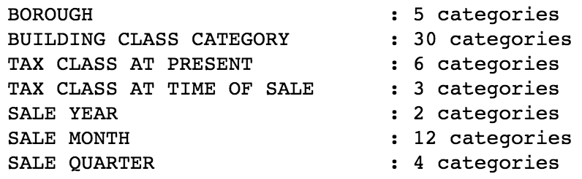
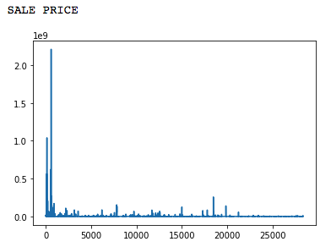

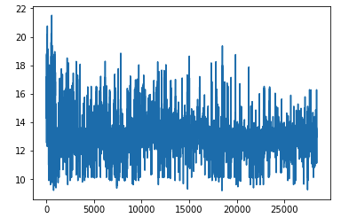

Data Preprocessing Cont.
Data transformation Cont.
Feature creation
Create one-hot encoded dummy variables for
categorical variables.
Normalization
Transform skewed numerical variables using log() function
to reduce skewness
Normalize all numerical features to [0, 1] with minmax normalizer

Slide 15

Data Preprocessing Cont.
Data Preprocessing Result
Number of total features: 72
Number of total data : 28372
Split the data into training (80%) and test (20%) sets.

Slide 16
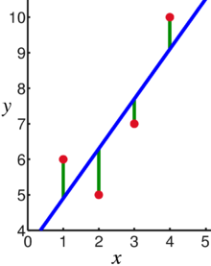
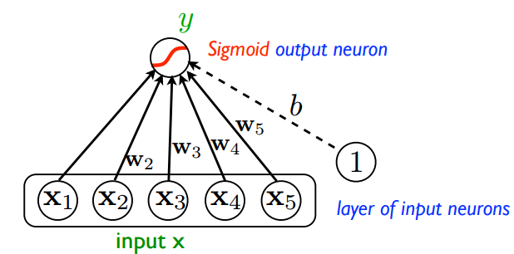
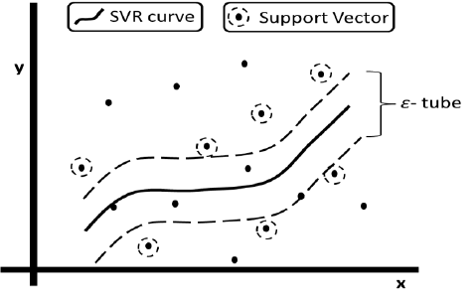

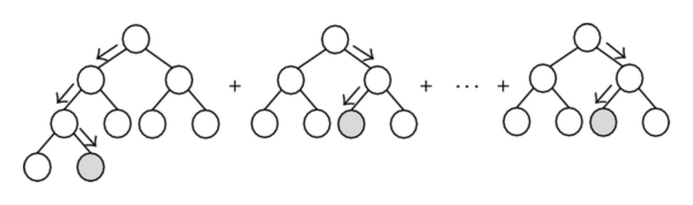
Modeling
Nueral Net Work

Slide 17
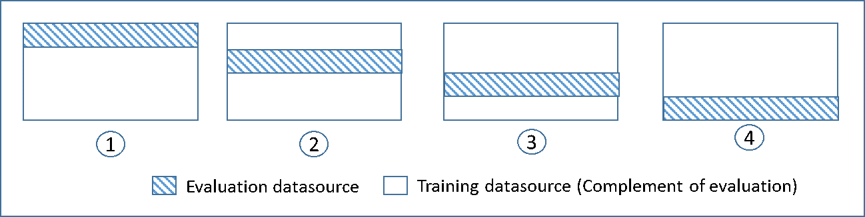
Training - Testing
SALE PRICE
count 28372
mean 0.344961
std 0.075317
min 0.000000
25% 0.306943
50% 0.337310
75% 0.371739
max 1.000000
Block
28372
0.340286
0.231512
0.000000
0.164644
0.301275
0.479971
1.000000
Month_May
28372
0.085648
0.279848
0.000000
0.000000
0.000000
0.000000
1.000000
…
Target

Slide 18
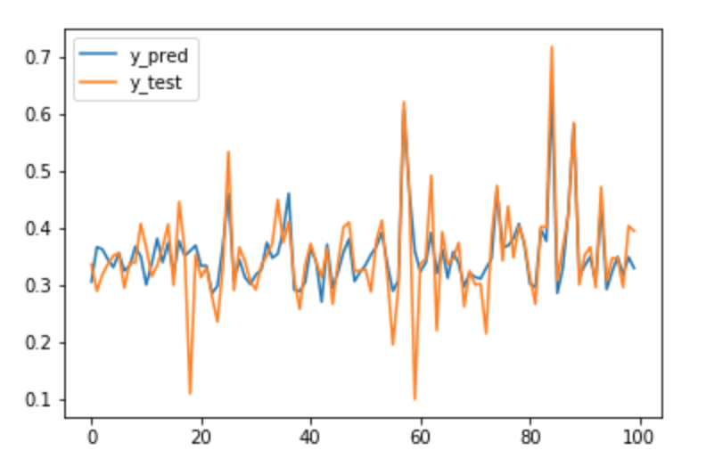
Linear Regression
y = a + bx + e
R-square = 0.51
MSE = 0.00270

Slide 19
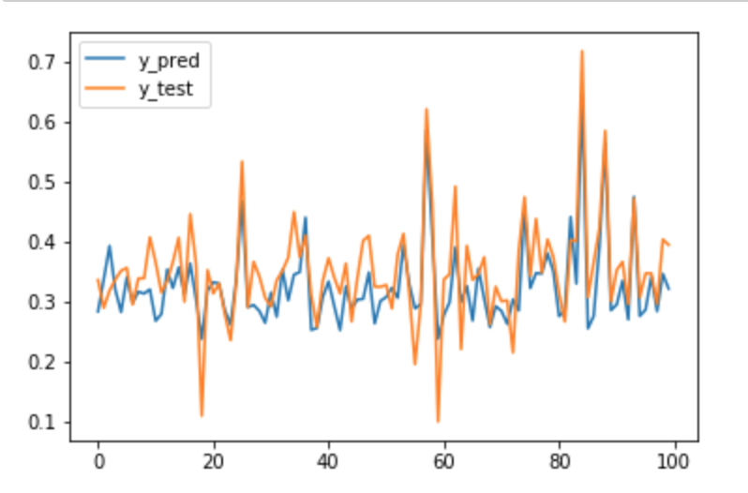
Support Vector Regression
R-square = 0.33
MSE = 0.003484

Slide 20

Neural Network
R-square = 0.55
MSE = 0.002471

Slide 21
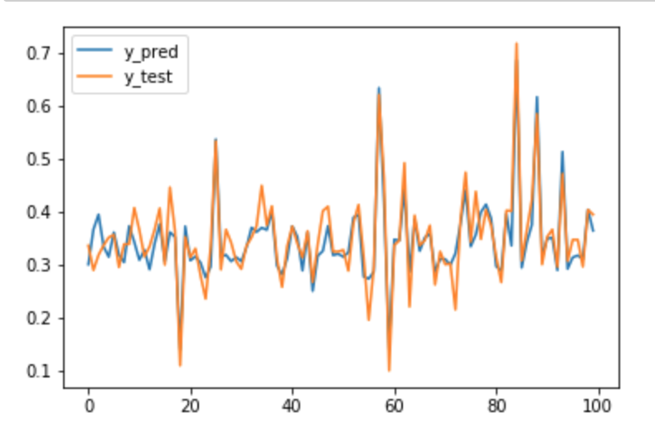
Random Forest
R-square = 0.67
MSE = 0.001823

Slide 22

Gradient Boosting
R-square = 0.64
MSE = 0.002471

Slide 23
Model Comparison
Best MSE
R2
51% | 33% | 55% | 67% | 64%
Linear Reg. | SVR | NN | Random Forest | Gradient Boosting

Slide 24
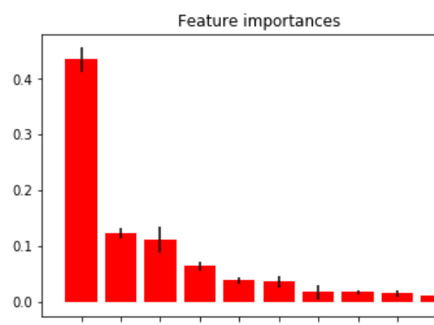
Best Features - Linear Regression
Gross Sq. ft.
Sq. ft
Lot
Other Hotels
Zip Code
Building Age
Coop - Elevator in
Borough_2
Block

Slide 25
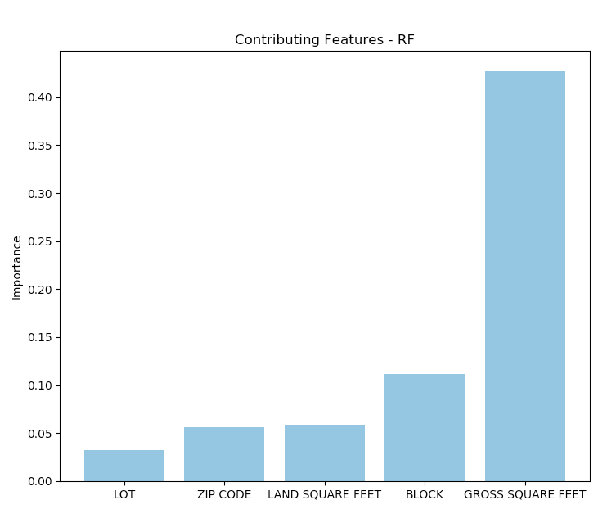
Best Features - Random Forest

Slide 26
Business Insight
What influences property sale price?
Does the presence of commercial units in and around property increase the demand and cost of property?

Slide 27
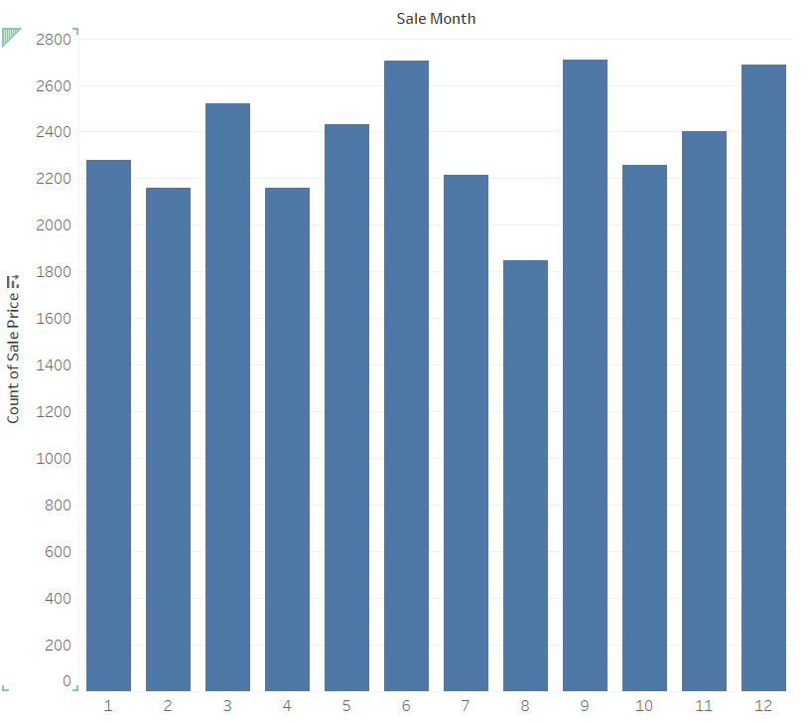
What are the peak transaction periods according to dataset?

Slide 28
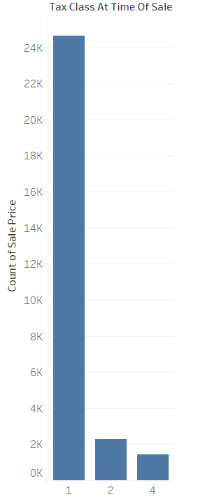
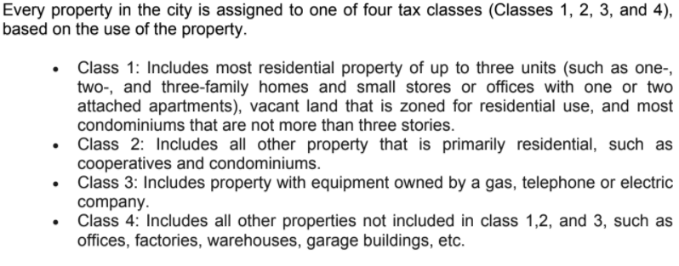
What kind of property people are interested in buying?

Slide 29
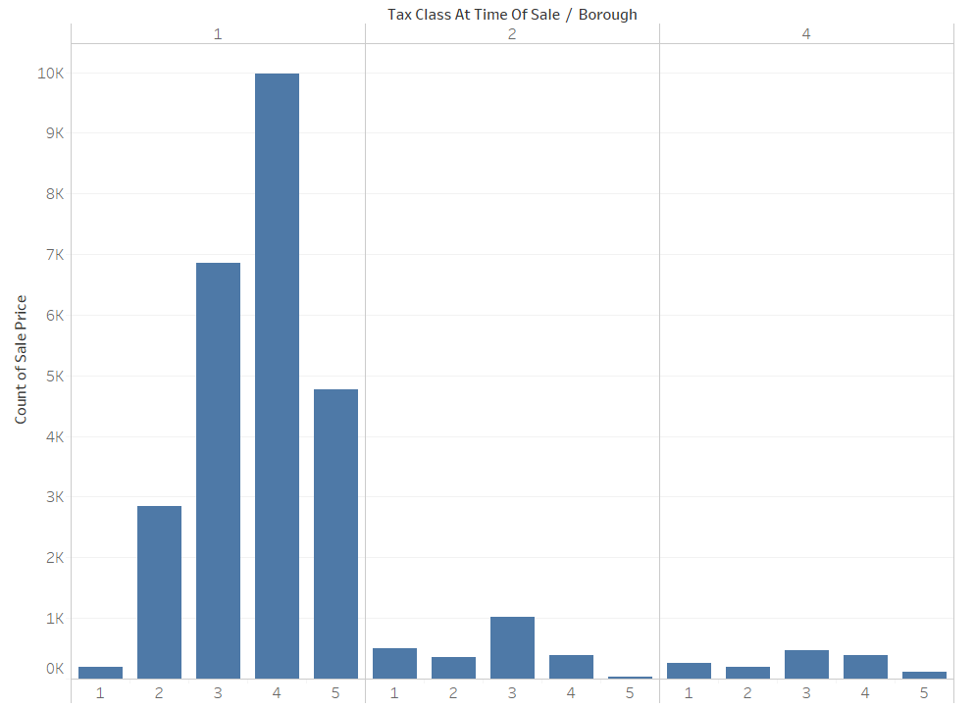
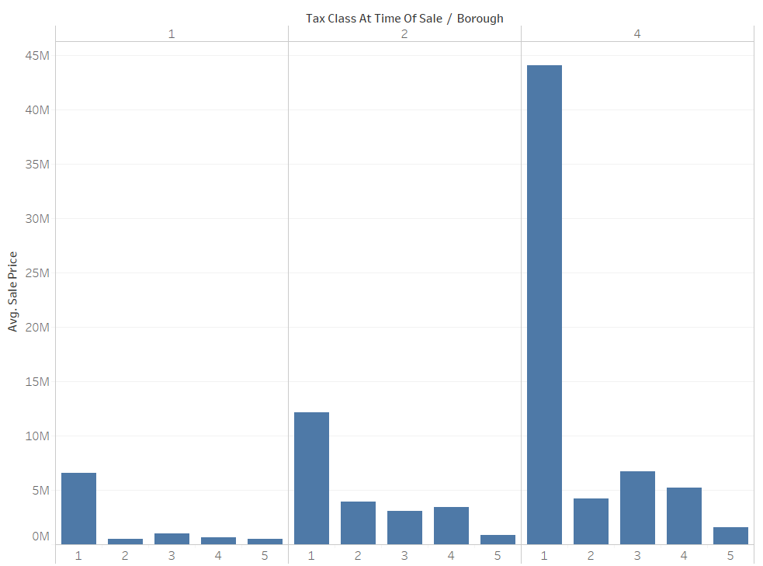
What are the most preferable locations in New york for property buying?
Manhattan - 1
Bronx - 2
Brooklyn - 3
Queens - 4
Staten Island - 5

Slide 30

THANKS!
Any questions?

Slide 31
Appendix
Glossary
http://www1.nyc.gov/assets/finance/downloads/pdf/07pdf/glossary_rsf071607.pdf

